Slide 1
Grand Tours, Projection Pursuit Guided Tours, and Manual Controls
Weber YC, Huang
Data Science Institution, TMU

Slide 2
Summary
It’s a chapter about Multivariate Statistical Analysis (多變量分析) with Data Visualization, using the application, GGobis, which is an open source visualization program for exploring high-dimensional data. (Noted that it can be use in R through package “rggobis”, see ggobis).
In this chapter, the method of how to perform high dimension variables in a low dimension screen is discussed.

Slide 3
Contents
1. Introduction
2. Tours
3. Using Tours with numerical methods
4. End notes

Slide 4
1. Introduction
Finding structure in multidimensional data when screen are only 2D?

Slide 5


What is projection ? (1/2)

Slide 6
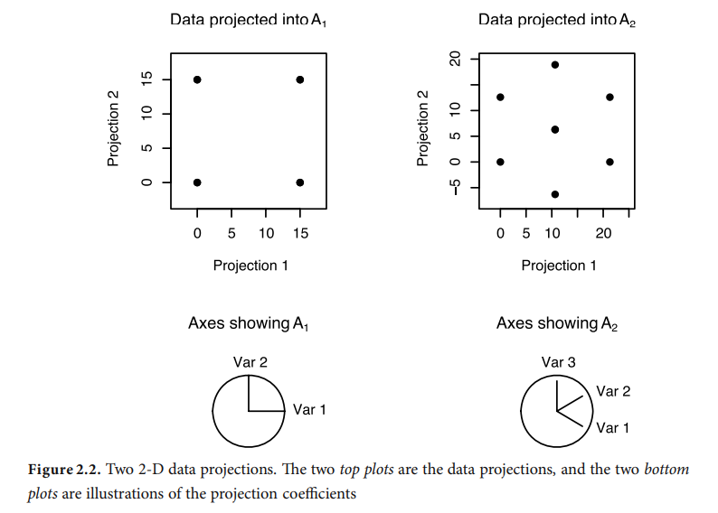
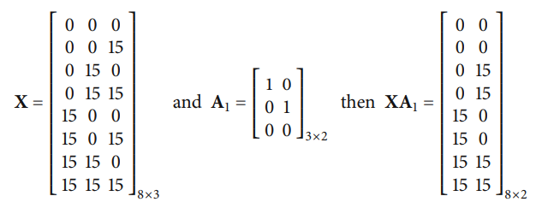
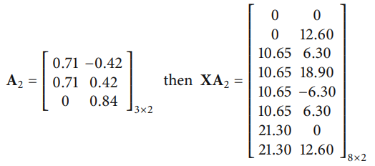
What is projection ? (2/2)
Mathematically, a projection of data is computed by multiplying an n x p data matrix (Dot Product)

Slide 7

The blind men and the elephant
Multi D -> 2D
Fisher linear discrimination ??
PP ??
PCA ??

Slide 8
Interpolation methods
As they are commonly called as “tours”:
Tours in GGobi :
Grand tour
PP guide tour
Manual control
When we use tours, what are we looking for in the data? We search for data projections that are not bell-shaped and, hence, not normally distributed, for example, clusters of points, outliers, nonlinear relationships, and low-dimensional substructures.

Slide 9
2. Tours

Slide 10
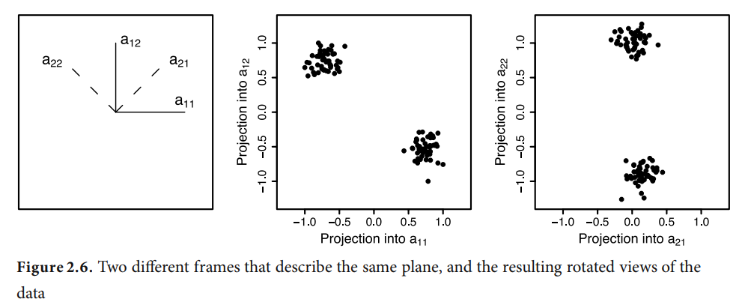
Movement of projection plane
Views of p-dimensional data can be computed in analogous ways
Rotating the entire p-dimensional data
Moving a d(< p)-dimensional plane through the space and projecting the data onto it.

Slide 11
Selecting the target plane
Grand tour uses a random selection of target plane.
Guided tour quantifies the structure present in each projection and uses this to guide the choice of target plane.
Manual controls let the user choose the target direction by manipulating the values of projection coefficients.

Slide 12
3. Using Tours with numerical methods

Slide 15
4. End notes

Slide 18
Title and Content Layout with Chart

Slide 19
Two Content Layout with Table
First bullet point here
Second bullet point here
Third bullet point here
Class | Group 1 | Group 2
Class 1 | 82 | 95
Class 2 | 76 | 88
Class 3 | 84 | 90

Slide 20
Title and Content Layout with SmartArt
Step 1 Title
Task description
Task description
Task description
Task description
Step 2 Title
Task description
Task description
Task description
Step 3 Title
Task description
Task description
Step 4 Title
Task description
Task description

Slide 21
Add a Slide Title - 1

